Slide 1
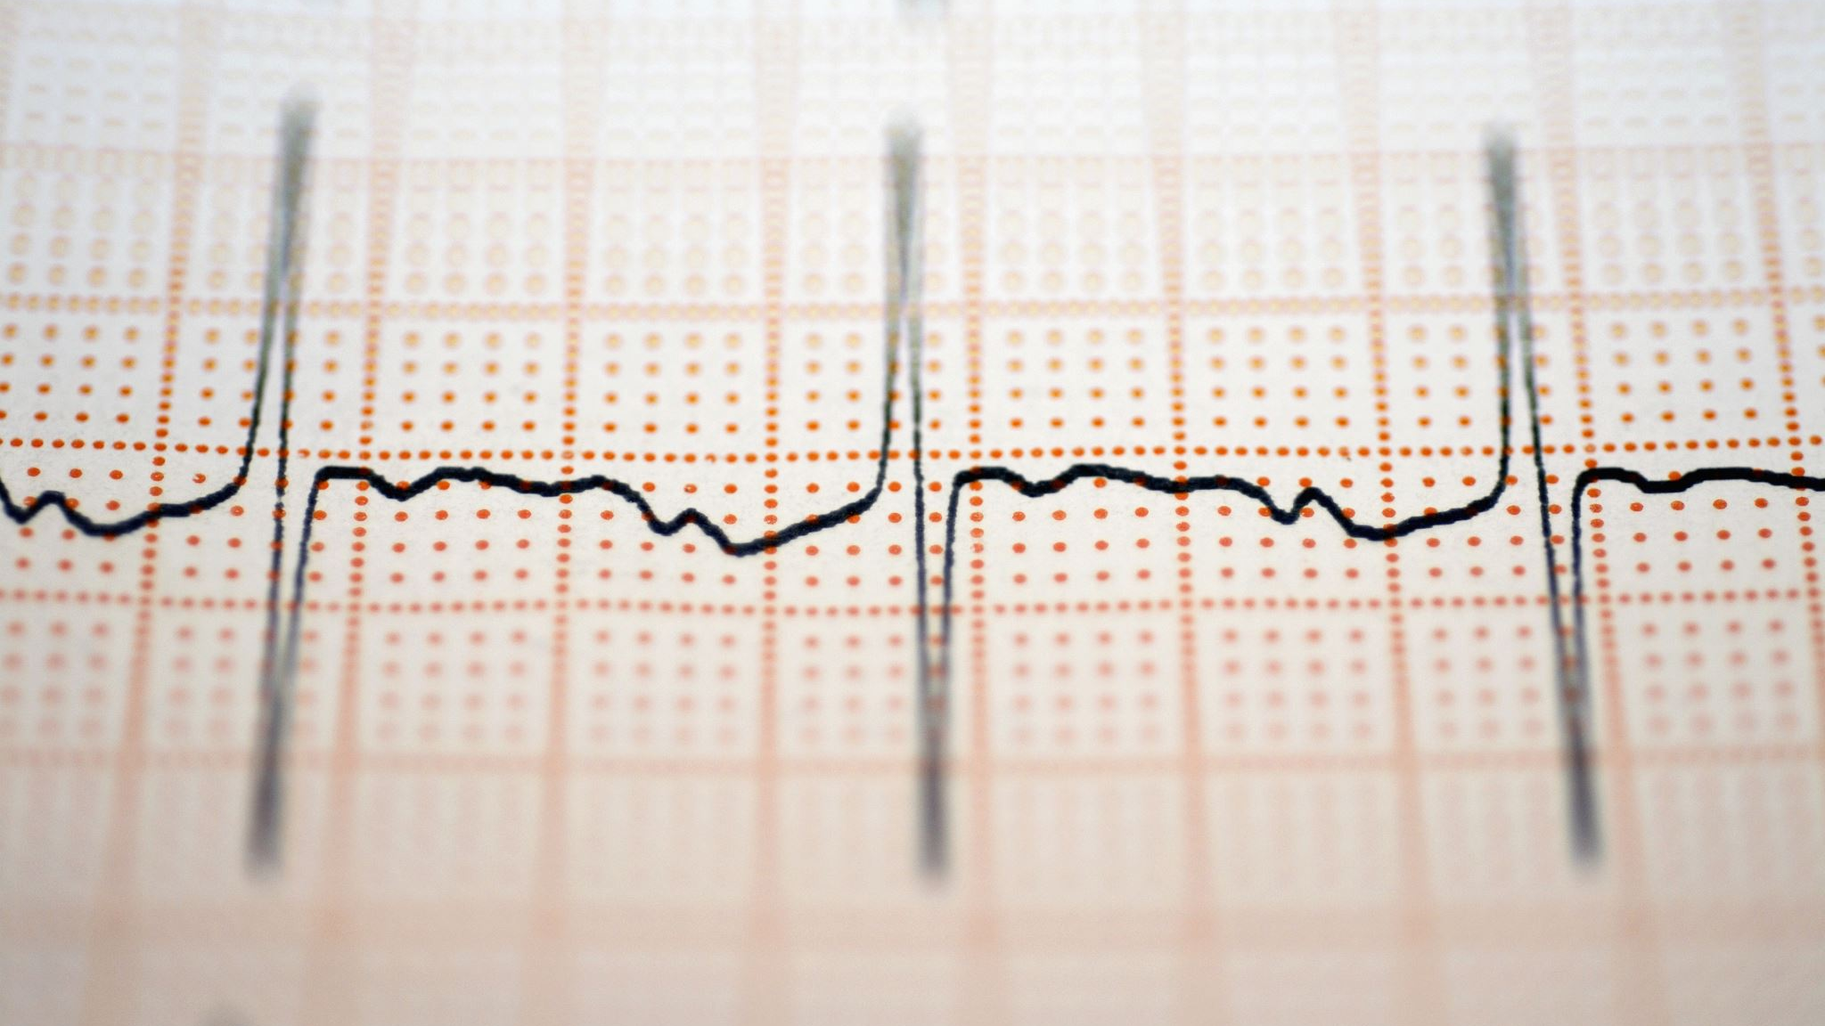
ADVANCED PARALLEL IMAGE ANALYSIS FOR LUNG AND COLON CANCER
Optimizing Performance Through High Parallel Processing
By:
Varsha Hindupur (NUID: 002935078)
Devki Patel (NUID: 002912471)

Slide 2
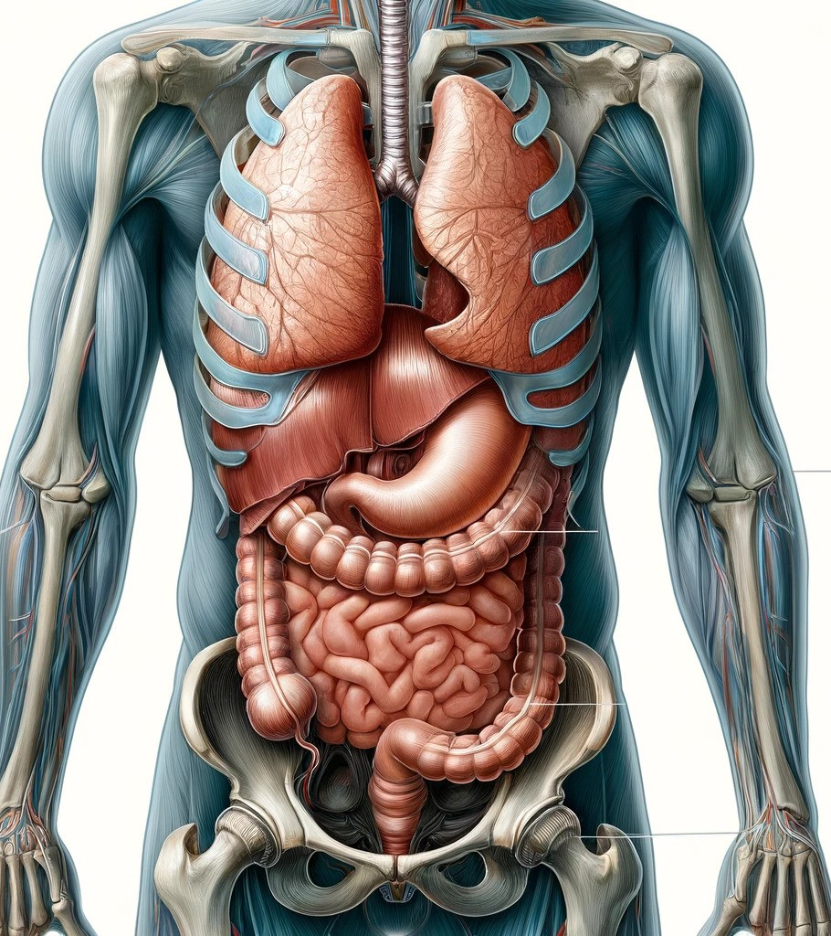
AGENDA
INTRODUCTION – Background, Motivation, Goals
DATASET Details
DATA LOADING parallelization
IMAGE data PRE-PROCESSING
Results: data loading CPU
Serial execution v/s ddp on cpu
RESULTS: SERIAL Execution
RESULTS: DDP (CPU)
SERIAL EXECUTION V/S DDP ON CPU v/s ddp on GPU
AUTOMATIC MIXED PRECISION & results
SPEEDUP, EFFICIENCY
CONCLUSION

Slide 3
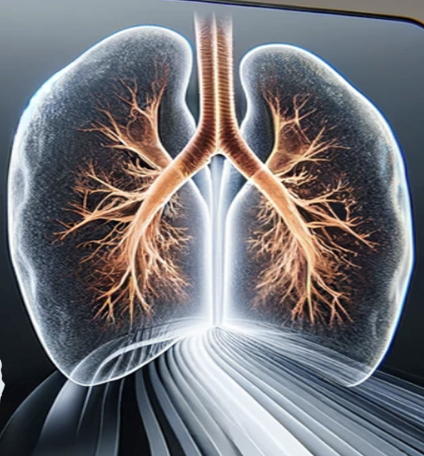
Introduction - background
Leveraging PyTorch's distributed computing capabilities, this project aims to accelerate the training of a deep learning model for lung and colon cancer image classification, harnessing the power of parallelism and GPU acceleration to achieve faster convergence and improved model performance

Slide 4
Introduction - motivation
Our choice for image classification is ResNet, a cutting-edge neural network designed for this purpose. However, its depth, while beneficial for accuracy, often leads to longer training durations.
In an era where swift model training is crucial, the growing need for high-performance parallel computation has driven us to meet the challenge head-on by optimizing and executing our models in parallel.

Slide 5
Introduction - GOAL
To significantly reduce the training time of image classification models through efficient high parallel computation, enabling faster experimentation and deployment in real-world scenarios.

Slide 6

Dataset details:
Source
5 Classes
DETAILS
Lung Benign Tissue
Lung Adenocarcinoma
Lung Squamous Cell Carcinoma
Colon Adenocarcinoma
Colon Benign Tissue
The images were generated from an original sample of HIPAA compliant and validated sources, consisting of 750 total images of lung tissue (250 benign lung tissue, 250 lung adenocarcinomas, and 250 lung squamous cell carcinomas) and 500 total images of colon tissue (250 benign colon tissue and 250 colon adenocarcinomas) and augmented to 25,000 using the Augmentor package
Obtained from Kaggle
Contains 25,000 histopathological images with 5 classes
Image Original size 768x768 pixels
Total Size: 2 GB

Slide 7
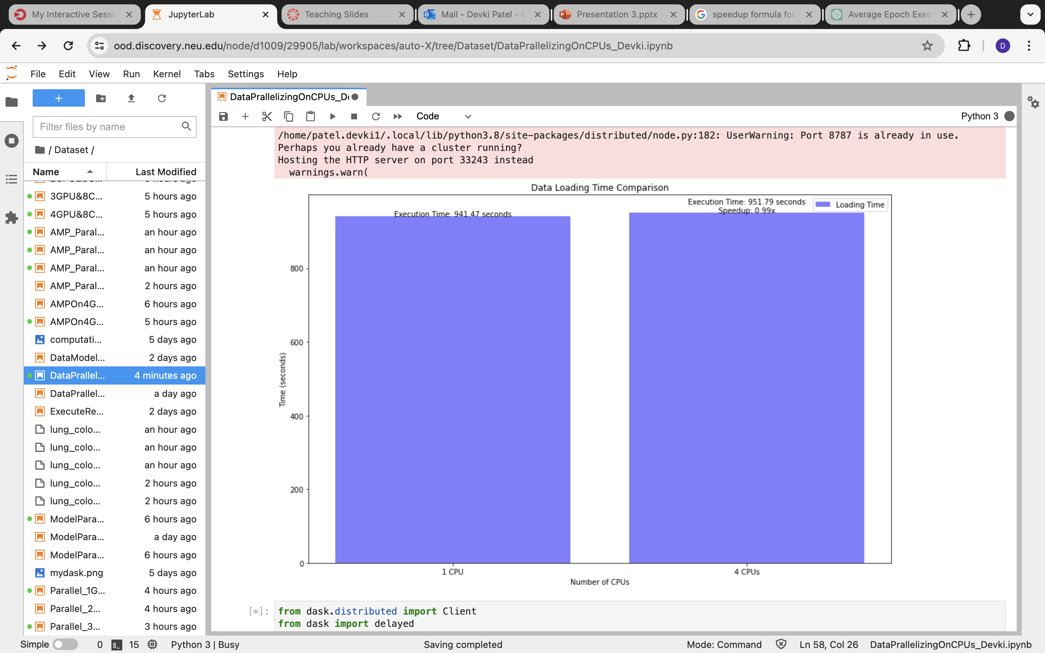
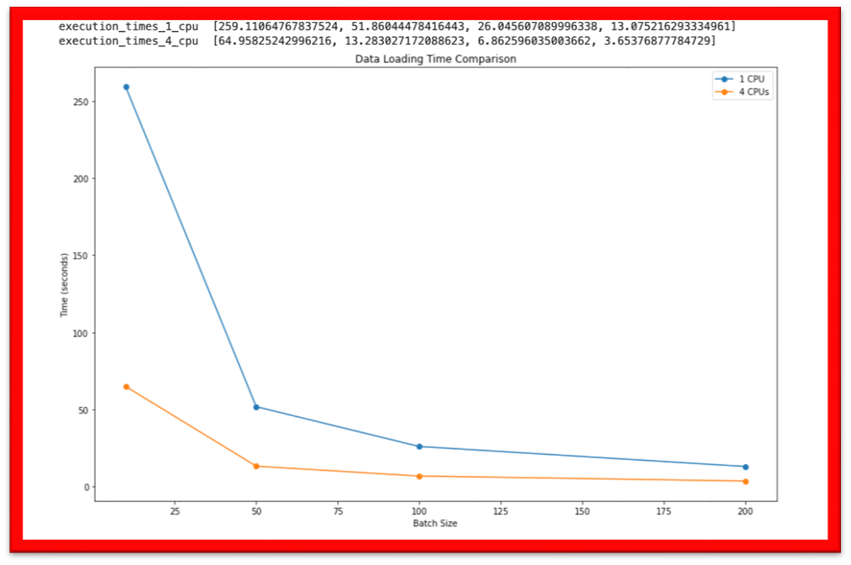
DATA LOADING PARALLIZATION:
Data Loading Without "batch_size" on
1 CPU and 4 CPU
Data Loading with Multiple "batch_size= 200" with Multiprocess.pool() on 1 CPU and 4 CPU

Slide 8
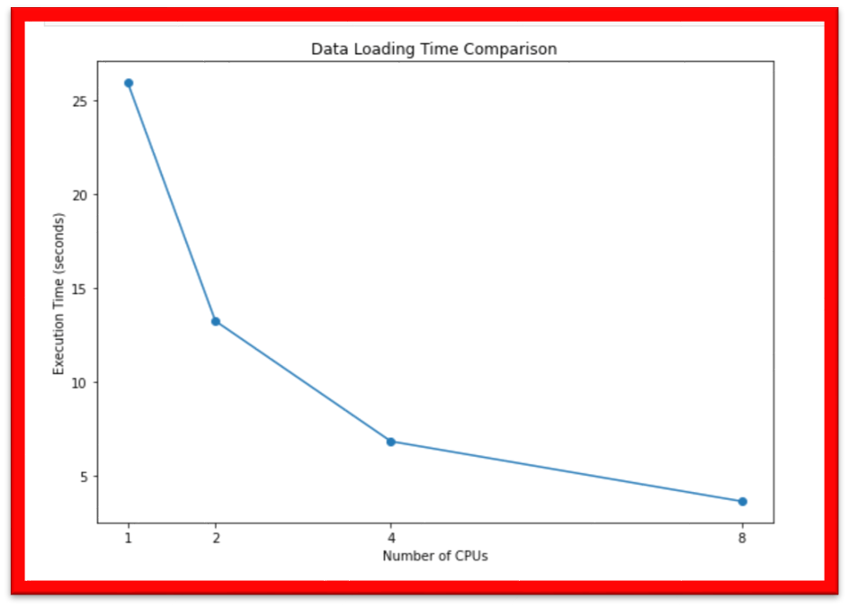
Results: Data Loading CPU
​Execution Device (CPU) | Batch Size | Average Execution Time (Seconds)
1 CPUs | 100 | 26.02
2 CPUs | 100 | 13.26
4 CPUs | 100 | 6.85
8 CPUs | 100 | 3.64

Slide 9
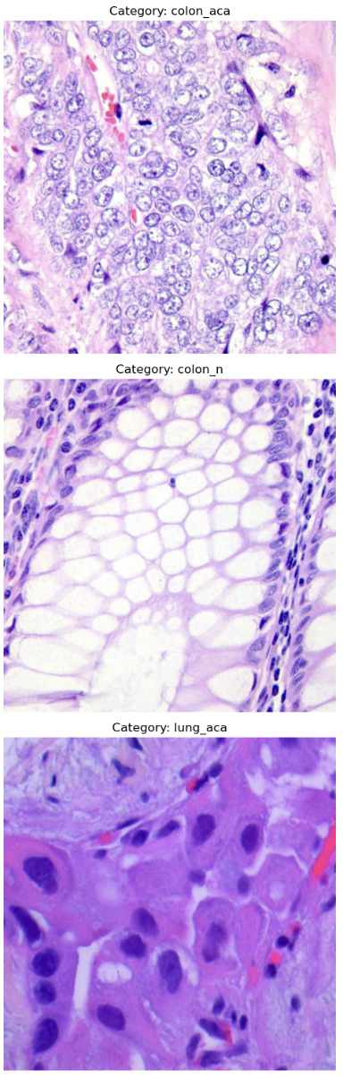
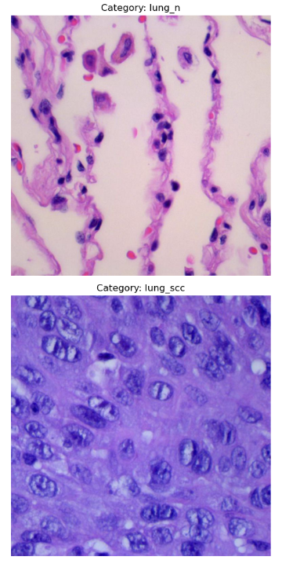
Image data pre-processing:
Resizing:
We resized images to fixed size of 128x128 pixels to ensure uniformity in input dimensions for our model.
Normalization:
We normalized the pixel values of the images to have a mean of 0 and a standard deviation of 1. Specifically, the pixel values were normalized to a mean of 0 and a standard deviation of 1.
Data Augmentation:
Random Flips and Rotations:
We applied random horizontal & vertical flips, as well as random rotations, to augment the training dataset.
This helps increase the diversity of the training data and improve the model's generalization ability.
Data Split:
Training, Validation, and Testing Split:
We split the dataset into three subsets: 80% for training, 10% for validation, and 10% for testing.
This ensures that the model is trained on a majority of the data, validated on a separate portion to tune hyperparameters, and finally tested on unseen data to evaluate its performance.

Slide 10
Serial Execution v/s DDP on CPU
Serial EXecution
DDP On CPU
Serial execution on CPU with ResNet50 doesn't necessarily mean that only one CPU core is utilized throughout the entire process. While tasks are executed sequentially, multiple CPU cores can still be involved in processing different parts of the task, but each core handles its portion of the task one after another, rather than simultaneously
This approach is straightforward but will lead to longer training times compared to parallel execution on multiple CPU cores or GPUs
Using Distributed Data Parallel (DDP) on CPU enables efficient parallelization of deep learning models training across multiple CPU cores.
This approach optimizes computation resources, enhancing scalability and performance without relying on GPU hardware.

Slide 11
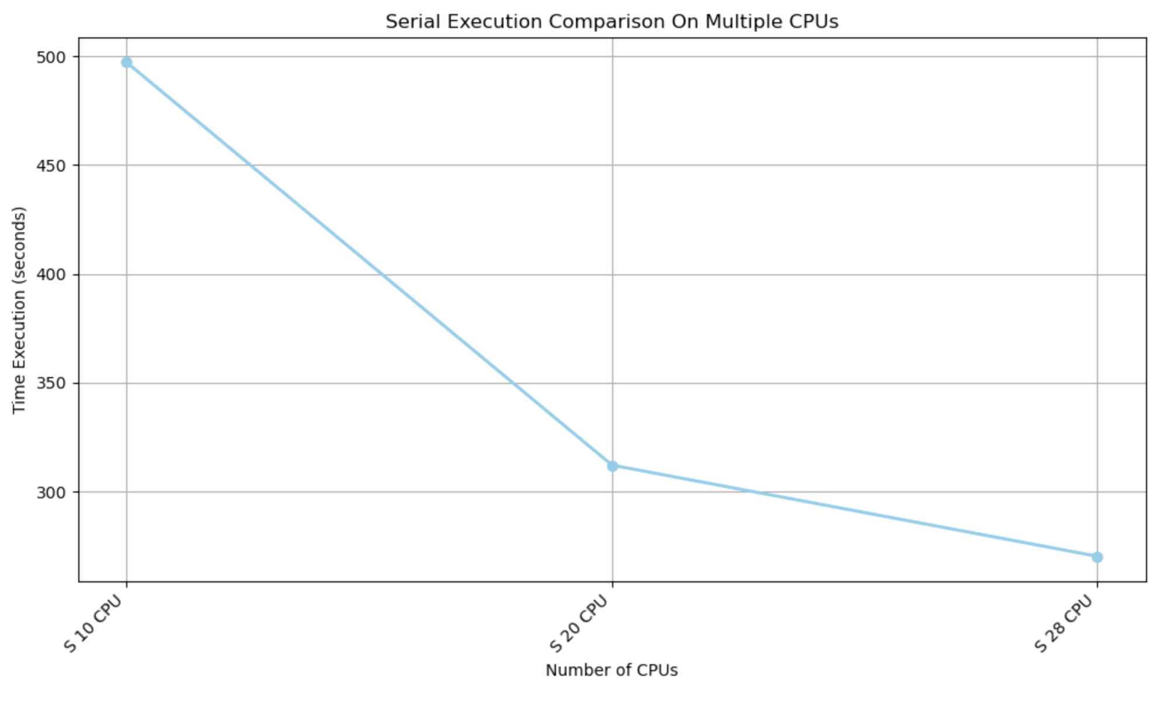
Results: SERIAL execution
​Execution Device (CPU) | Batch Size | Execution Method | Model | Average Execution Time (Seconds)
10 CPU | 1000 | Serial | Resnet50 | 497.09
20 CPU | 1000 | Serial | Resnet50 | 312.09
28 CPU | 1000 | Serial | ResNet 50 | 270.22

Slide 12
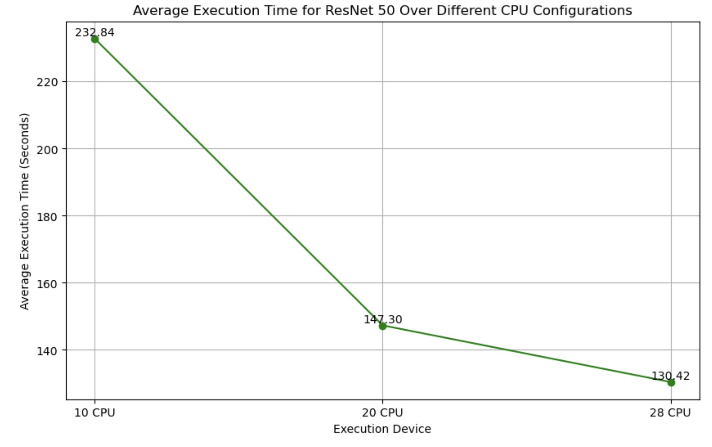
Results: DDP (CPU)
​Execution Device (DDP CPU) | Model | Average Execution Time (Seconds)
10 CPU | ResNet 50 | 232.84
20 CPU | ResNet 50 | 147.30
28 CPU | ResNet 50 | 130.42

Slide 13
Serial Execution v/s DDP (CPU & GPU)
Serial EXecution
DDP On CPU
DDP On GPU
Serial execution on CPU with ResNet50 doesn't necessarily mean that only one CPU core is utilized throughout the entire process. While tasks are executed sequentially, multiple CPU cores can still be involved in processing different parts of the task, but each core handles its portion of the task one after another, rather than simultaneously
This approach is straightforward but will lead to longer training times compared to parallel execution on multiple CPU cores or GPUs
Using Distributed Data Parallel (DDP) on CPU enables efficient parallelization of deep learning models training across multiple CPU cores
Approach optimizes computation resources, enhancing scalability and performance without relying on GPU hardware
Utilizes the parallel architecture of GPUs to dramatically shorten the training time for complex neural networks through concurrent execution
Enhances scalability and efficiency, enabling the processing of larger datasets with faster convergence compared to CPU execution

Slide 14
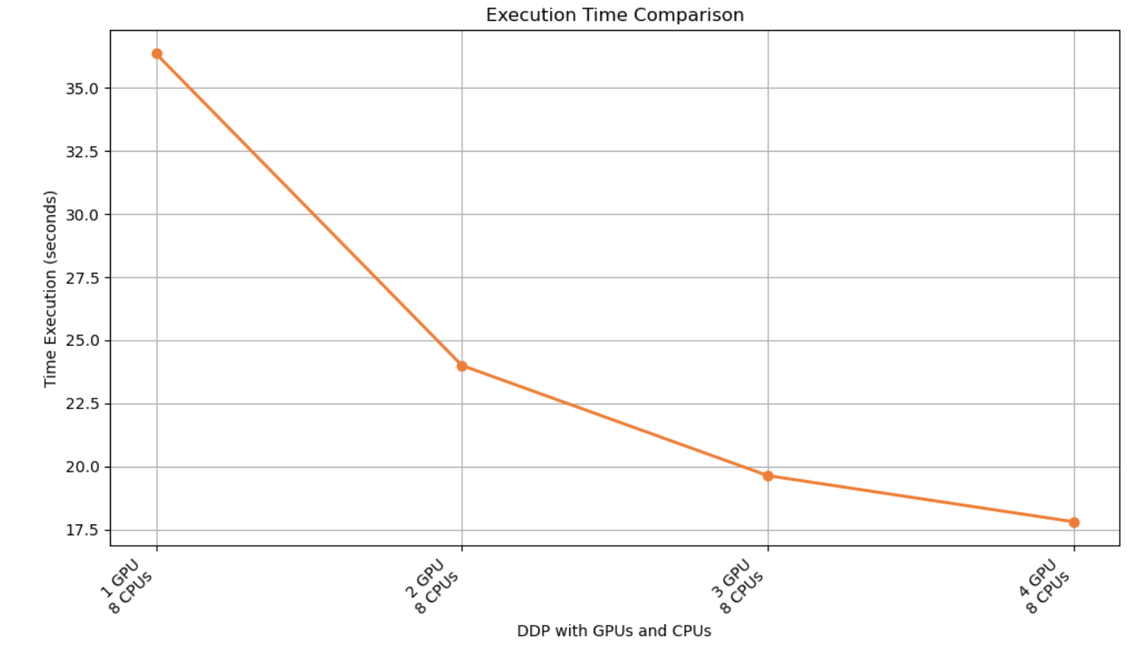
Results: DDP (GPU)
​Execution Device (CPU + GPU) | Batch Size | Model | Average Execution Time (Seconds)
1 GPU, 8 CPUs | 1000 | ResNet 50 | 36.36
2 GPU, 8 CPUs | 1000 | ResNet 50 | 24.0023
3 GPU, 8 CPUs | 1000 | ResNet 50 | 19.63
4 GPU, 8 CPUs | 1000 | ResNet 50 | 17.80

Slide 15
Amp (automatic mixed precision)
Automatic Mixed Precision (AMP) is a technique used in deep learning frameworks like PyTorch to automatically manage the precision of computations during training, typically using a combination of single and half precision
AMP dynamically selects the appropriate precision (32-bit or 16-bit) for different parts of the neural network during training based on factors like numerical stability and memory usage
By using half-precision (16-bit) floating-point numbers for most computations, AMP reduces the memory footprint of the model, allowing for larger batch sizes or more complex models to fit into GPU memory
With reduced precision, AMP accelerates training by exploiting the faster arithmetic capabilities of modern GPUs optimized for half-precision operations
AMP mitigates the issue of numerical underflow by scaling up the loss value before backpropagation and then scaling it back down afterward, preserving the accuracy of gradients
AMP dynamically adjusts the loss scale during training to prevent gradients from becoming too small or too large, ensuring stable convergence
AMP is compatible with most modern GPU architectures and works seamlessly with popular deep learning libraries like PyTorch

Slide 16
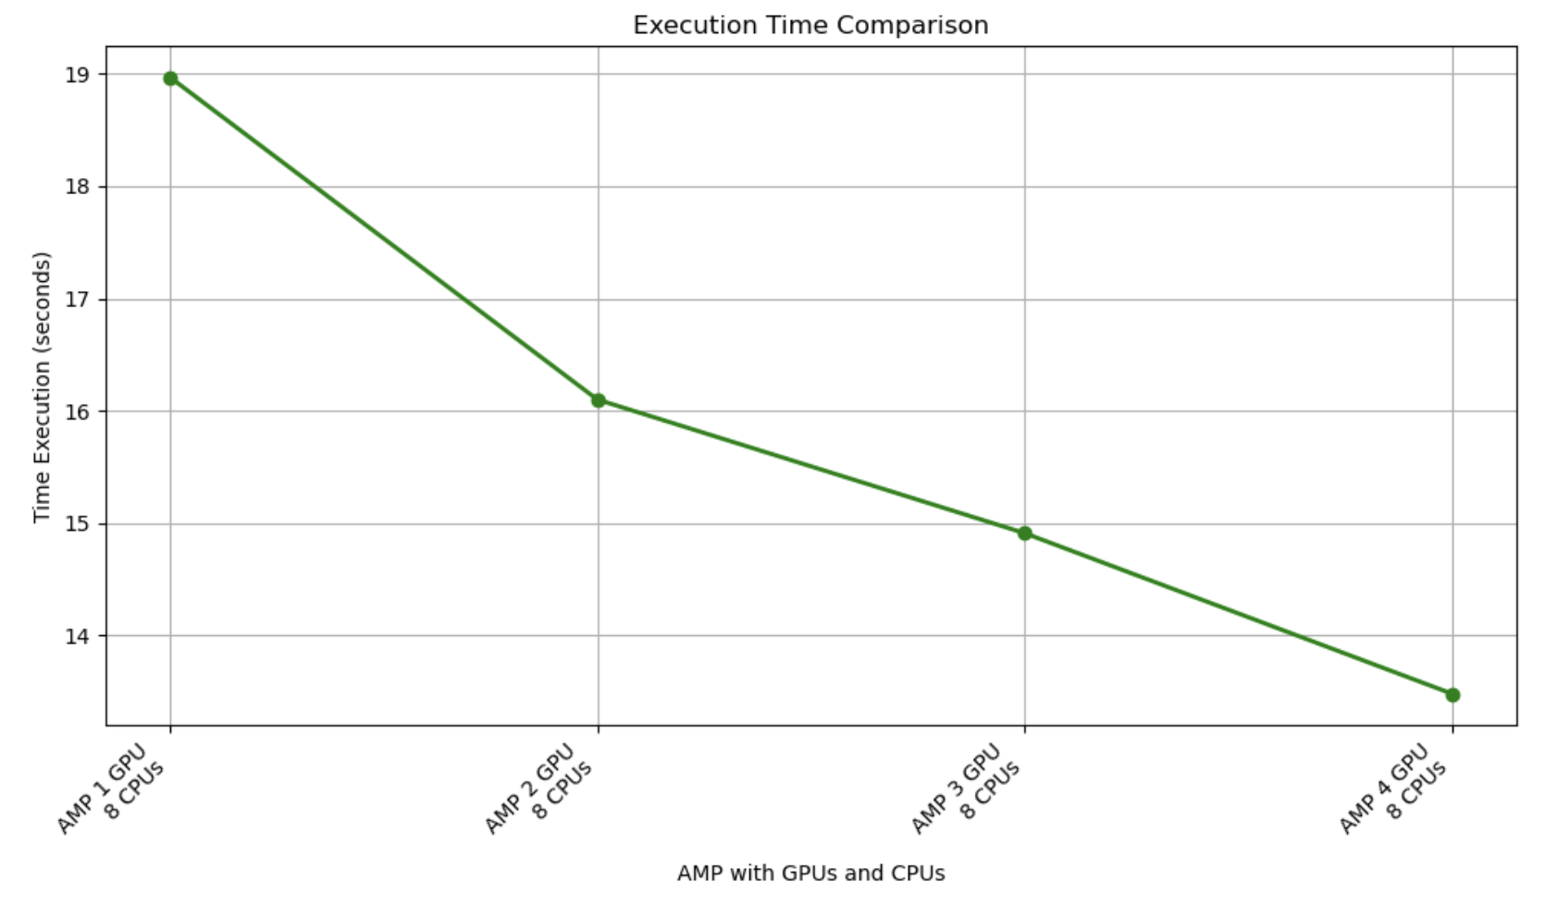
Results: AMP
​Execution Device (CPU + GPU) | Batch Size | Model | Average Execution Time (Seconds)
AMP 1 GPUs, 28 CPUs | 1000 | ResNet50 | 18.97
AMP 2 GPUs, 28 CPUs | 1000 | ResNet50 | 16.10
AMP 3 GPUs, 28 CPUs | 1000 | ResNet50 | 14.91
AMP 4 GPUs, 28 CPUs | 1000 | ResNet50 | 13.48

Slide 17
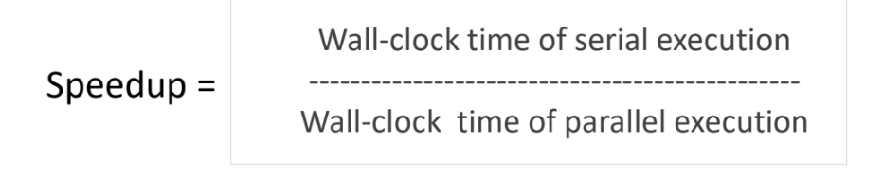
SPEEDUP
CPU SpeedUp:
328.24 / 130.42 = 2.51 times
GPU SpeedUp:
328.24 / 17.8 = 18.44 times
AMP SpeedUp:
328.24 / 13.48 = 24.35 times
Sp

Slide 18

Efficiency
CPU Efficiency:
2.51 / 28 = 0.08 times
GPU Efficiency:
18.44 / 8 = 2.30 times
AMP Efficiency:
24.35 / 28 = 0.86 times

Slide 19
SUMMARY
Our experimental results tell a compelling story of transformation. We witnessed the execution time for data loading plummet from over 3155 seconds using serial approaches to mere seconds with the integration of DDP and GPU utilization. The substantial reduction in training times from hours to seconds opens new horizons for rapid experimentation and the potential for timely clinical application.
The efficiency of the CPU parallel execution is 0.08 times, or 8%. This low number indicates that the parallelization on the CPU is not very efficient.
The efficiency for GPU execution is 2.30 times, or 230%.
Summarizing the execution process, when employing Automatic Mixed Precision (AMP) with varying GPU resources, we observed the following execution times: 18.97 seconds with 1 GPU, 16.10 seconds with 2 GPUs, 14.91 seconds with 3 GPUs, and 13.48 seconds with 4 GPUs.
Summarizing the execution process, when employing Automatic Mixed Precision (AMP) with varying GPU resources, we observed the following execution times: 18.97 seconds with 1 GPU, 16.10 seconds with 2 GPUs, 14.91 seconds with 3 GPUs, and 13.48 seconds with 4 GPUs.

Slide 20

THANK YOU

